Slide 1

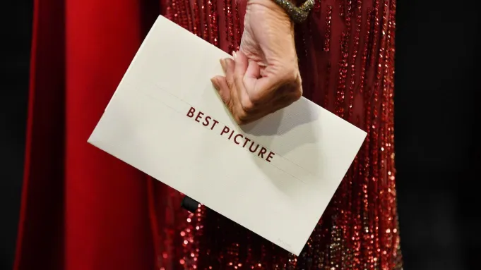
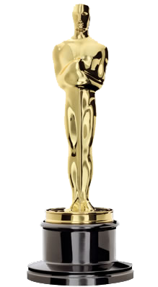
DATA SCIENCE PROJECT
1

Slide 2

Ido Mizrahi - 204392328
Nika Lomashvili - 320820145
2

Slide 3

Introduction
The Academy Awards, popularly known as the Oscars, are awards for
artistic and technical merit in the film industry. They are regarded by
many as the most prestigious and significant awards in the
entertainment industry worldwide.
Our project deals with Oscar nominees in the field of
Best Picture of the Year, In the project we are trying
to find out with the help of machine learning which
films will be nominated for Oscars.
3

Slide 4

Data acquisition
We crawled movies data from IMDB site.
Data about all movies from IMDB genre by genre from this link.
Code In 2.
Data about nominee movies from IMDB from this link.
Code In 4.
We created Row Data frame from this two data sources
Code In 59.
4

Slide 5
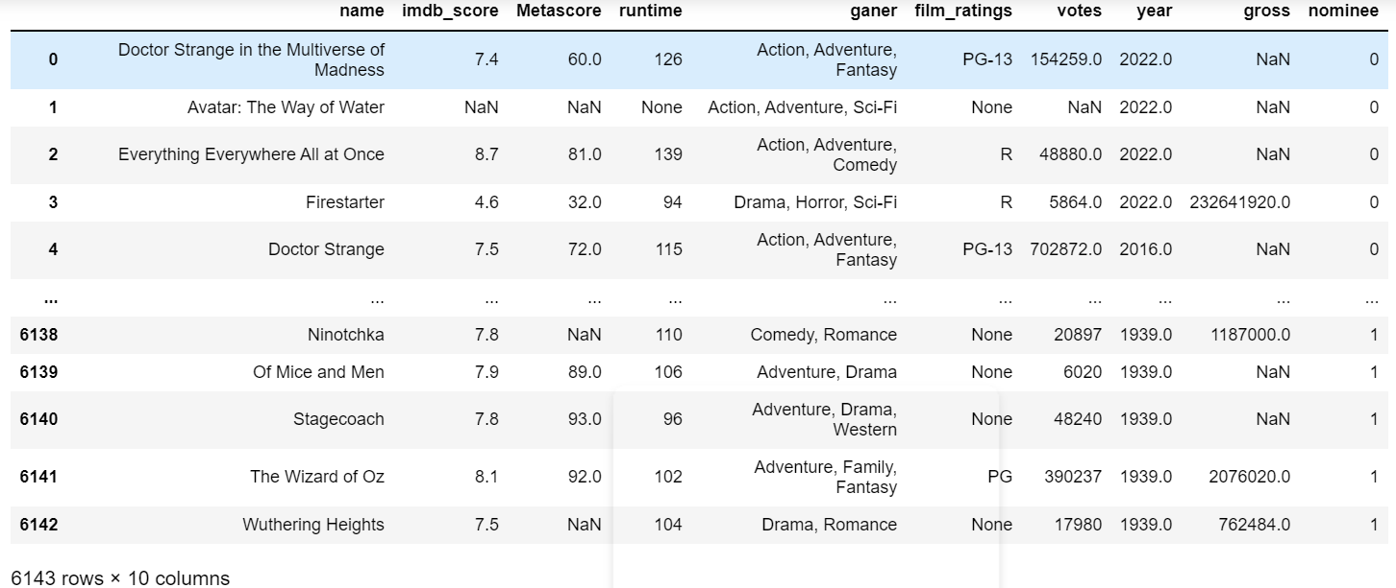
The Row Data frame
Data size:61,430
5

Slide 6
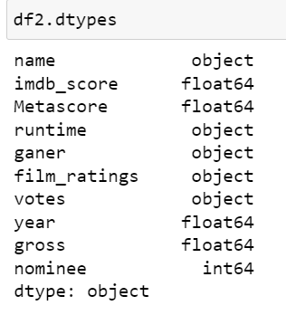
The Row Data frame
Df columns:
Name- the name of the movie (to detect duplicated rows).
Imdb score-imdb ranking of the movie.
Metascore –the Metascore of the movie.
Runtime- the length of the movie
Film rating- the legal age you can see the movie.
Year – the publish year of the movie.
Gross- the gross of the movie.
Nominee- the target column of the df , 1 for movies that are Nominees of the best picture Oscar award.
6

Slide 7
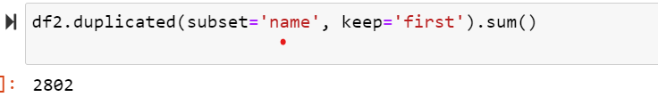
Data analysis and optimization
We do the steps below:
count duplicates- we have 2497 duplicated rows, because of movies that are multi genre movies.
7

Slide 8
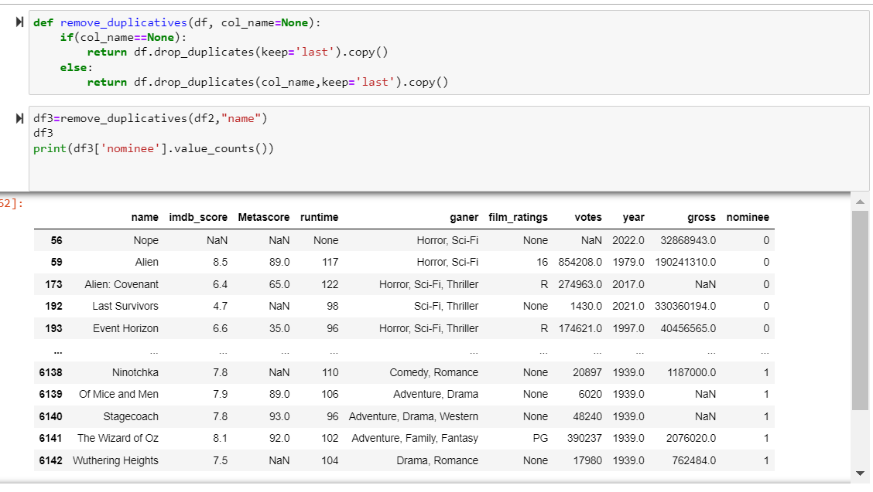
Data analysis and optimization
Removed duplicates-
8

Slide 9
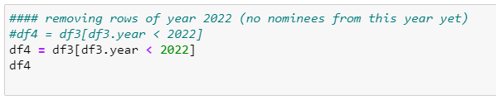
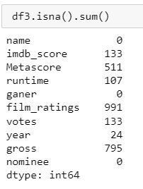
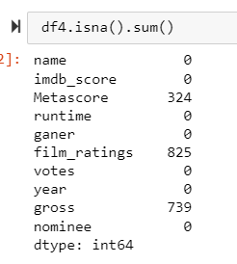
Data analysis and optimization
Remove movies from year 2022 and above from data frame, because that nominees of 2022 and above not yet published.
the result:
to
9

Slide 10
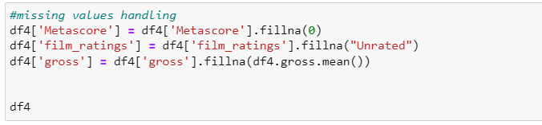
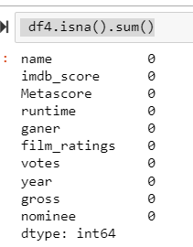
Data analysis and optimization
Fillan missing data-
to
10

Slide 11
Data analysis and optimization
Remove corrupt rows-
we didn’t use this function because we don’t have null’s in df after the previous steps.
Outliers- we didn’t use this function because , he detects some of the nominees as Outliers because high params, and we didn’t want to drop ani nominee row. We have only 480 nominees.
11

Slide 12
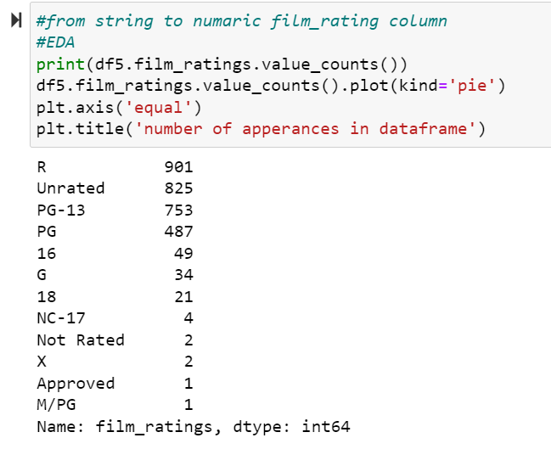
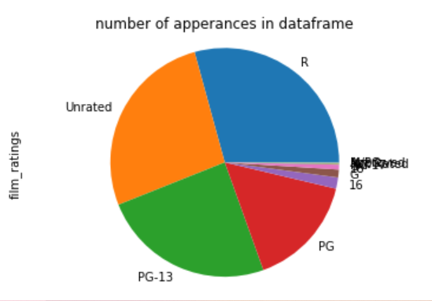
Data handling
Film ratings column: string to numeric-
we can see that the data type of this column is string, but we can Easily transfer it into numeric data type (because the data on this column is scale type string).
12

Slide 13
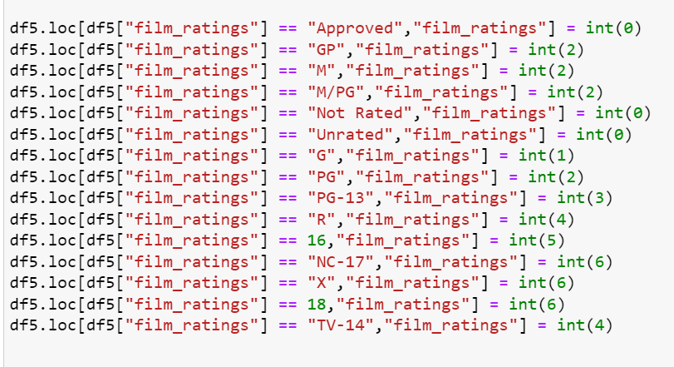
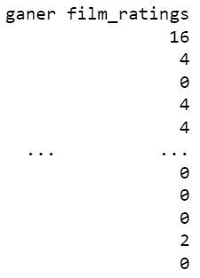
Data handling
Film ratings column: string to numeric-
The result:
13

Slide 14
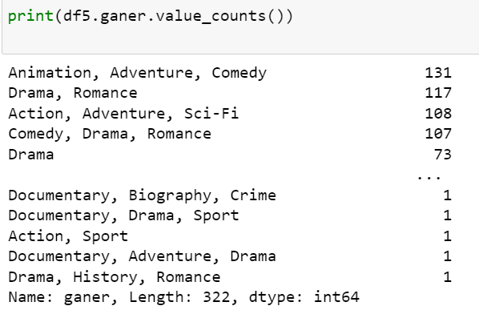
Data handling
Film genre column: string to numeric-
In this column we see the genres of the movie (can be more that one):
We used text analysis techniques to transfer this string to Bolen vector of genres.
14

Slide 15
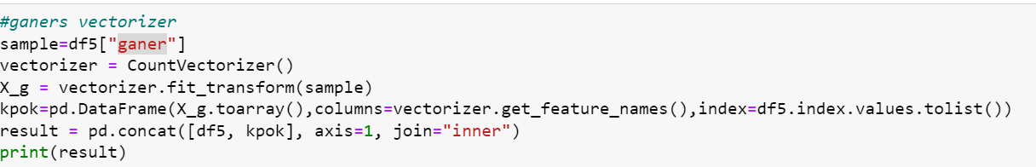
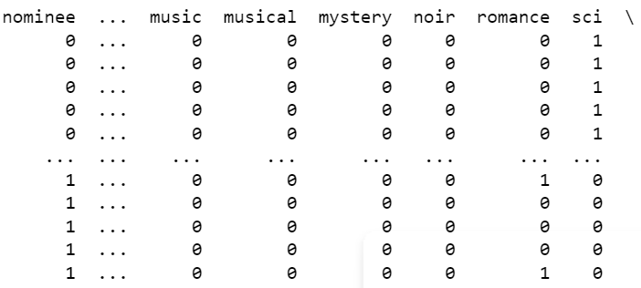
Data handling
Film genre column: string to numeric-
The result:
15

Slide 16
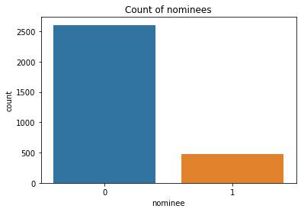
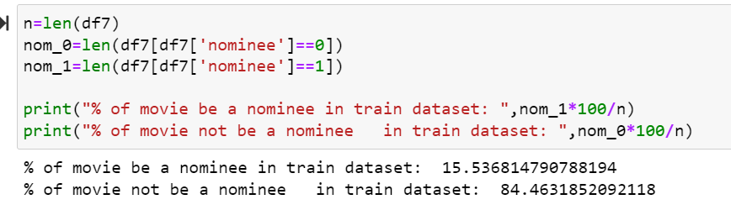
Exploratory Data Analysis and Visualization
We can see that after the cleaning of the data we have around 500 nominee movies and around 2500 not nominee movies.
16

Slide 17
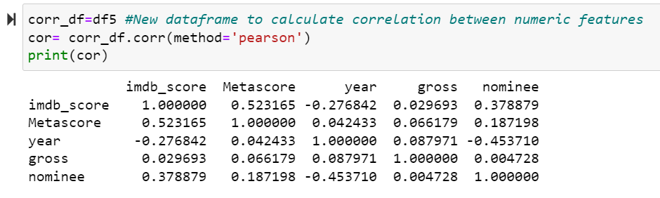
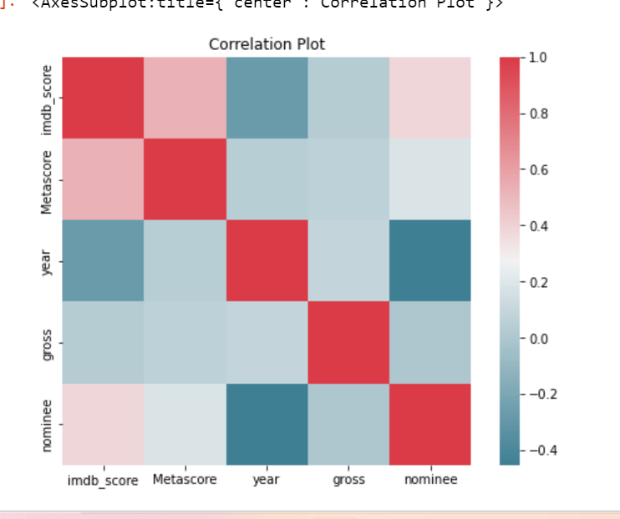
Exploratory Data Analysis and Visualization
Correlations:
We can see that columns with a good correlation is imdb score and metescore 0.523167.
17

Slide 18
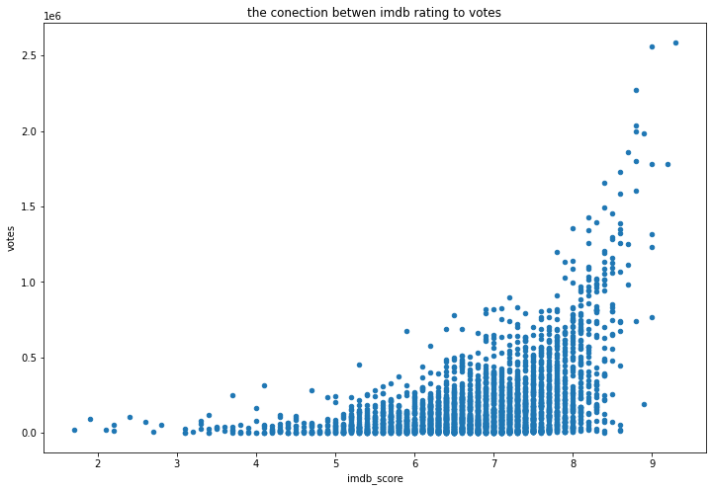
Exploratory Data Analysis and Visualization
We wanted to see the connections between columns:
We can see that the columns of imdb score and votes are very correlated.
We can see that the columns of imdb score and votes are very correlated.
18

Slide 19
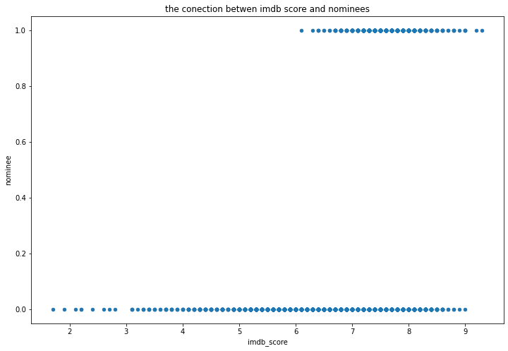
Exploratory Data Analysis and Visualization
The connection between Imdb score to target column:
we can see that all the nominees get
imdb score between 6 to 9.
19

Slide 20
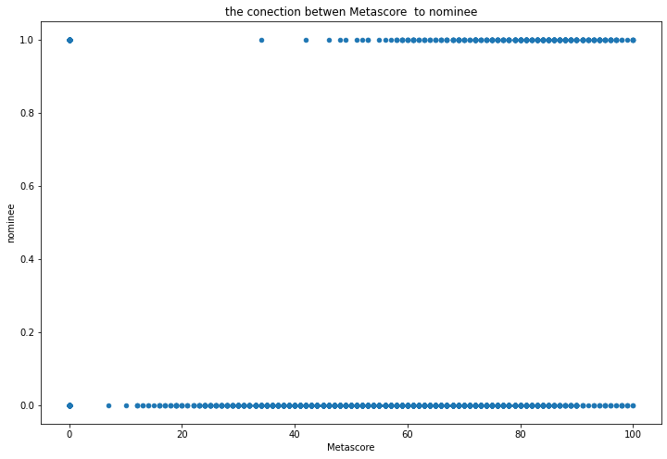
Exploratory Data Analysis and Visualization
The connection between metascore to target column:
in the this graph we can see that
most of nominees get between
40 to 100 score.
20

Slide 21
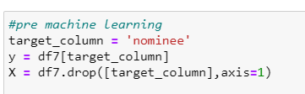
machine learning
Df train test split :
21

Slide 22
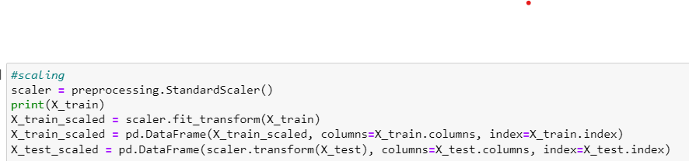
machine learning
We scaled df with the standard scaler:
22

Slide 23
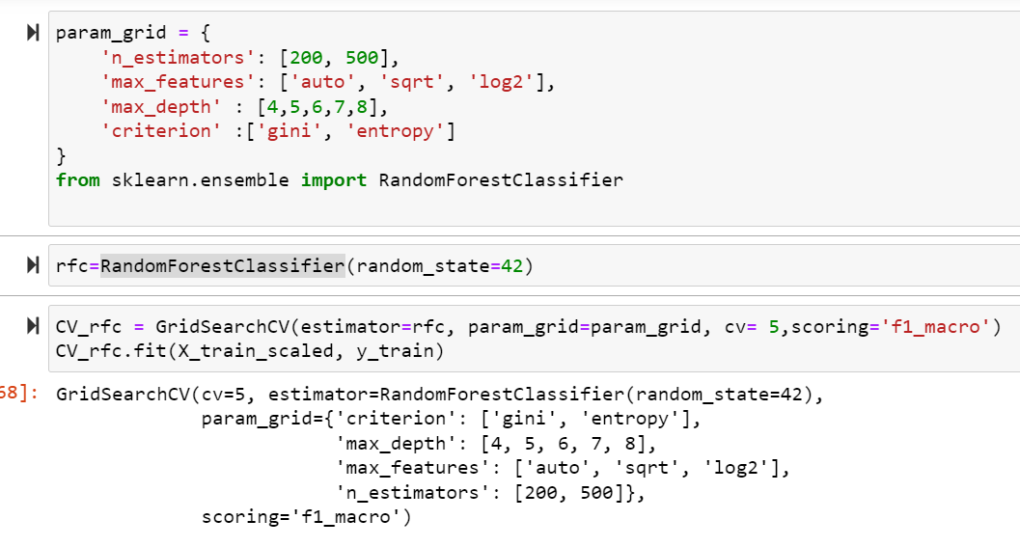
machine learning
We chose RandomForest for the classification (we get with it best f1 score):
To chose hyper params with use of GridSherchCV:
23

Slide 24
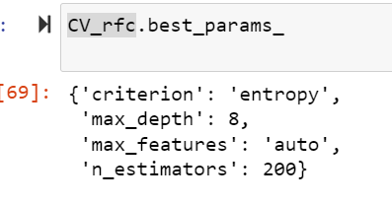
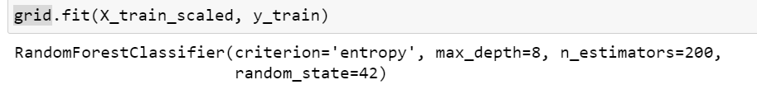
machine learning
And we get that best params is:
We trained the random forest algorithm with tis params:
24

Slide 25
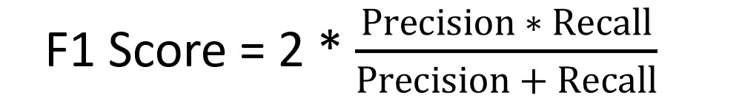
model evaluation
In the project proposal we chose that we want to get best f1 macro score (because he is a combination of precision and recall )
25

Slide 26
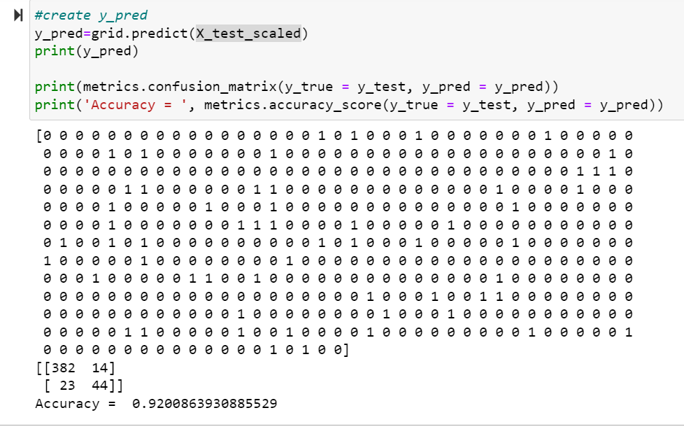
model evaluation
We predicted y_test:
We get accuracy of 0.92 very good score.
26

Slide 27
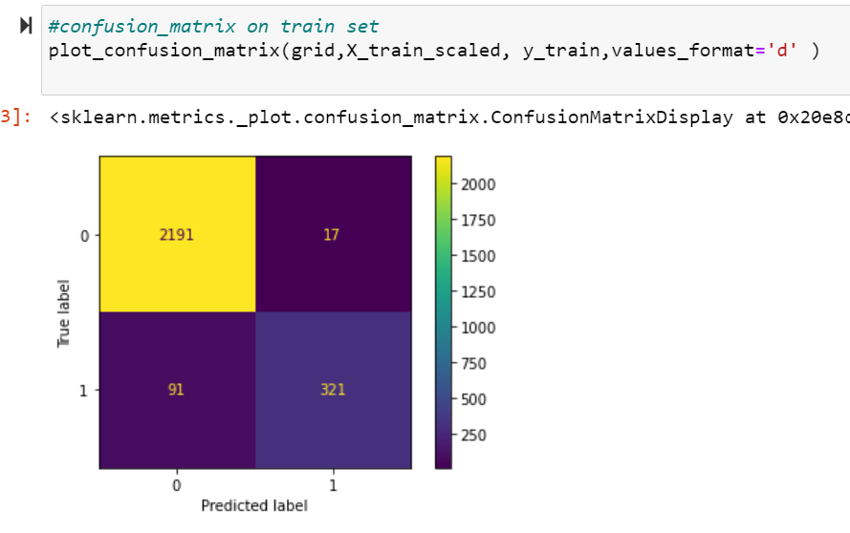
model evaluation
Confusion matrix of test set:
We can see that most of the elements are tp and tn.
27

Slide 28
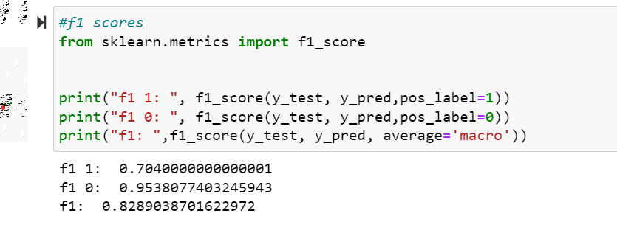
model evaluation
F1 score:
we get good f1 score on
The two types of the
Classification on ones and
On zeros.
And a very macro score of
0.828.
28

Slide 29
summery
We wanted to see if we can detect which of the movies on imdb site will be a nominee of best picture film Oscar award.
We should here that with a good info crewing and a good data cleaning and handling and use of random forest algorithm we can predict with a good assurance which movie will be a nominee of best picture film Oscar award with 0.828 f1 macro score.
29

Slide 30
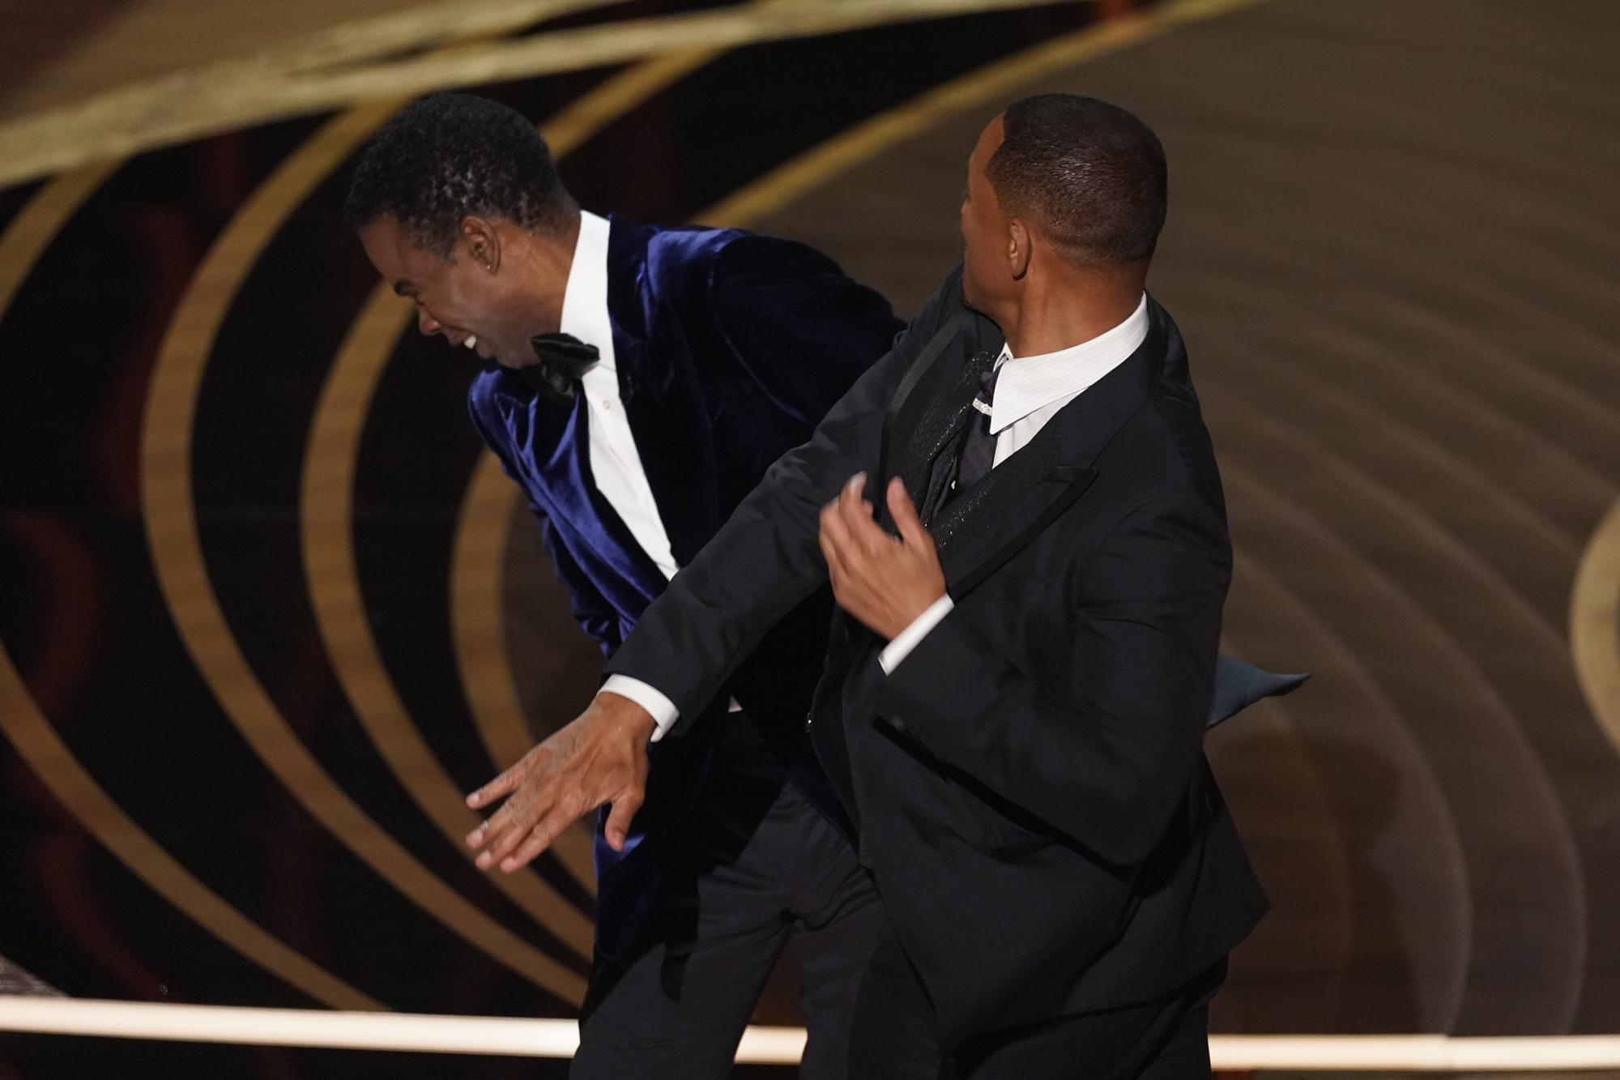
Conclusions
Our conclusion is that a machine can not know for sure who will be the Oscar nominees, but the machine does a good job of discovering most of the films that will be Oscar nominees for the best picture of the year
30

